Slide 1
UML Package Diagrams
Cory Yelverton

Slide 2
Definitions
Package – a group of elements that are related. If you remove a package from a model so goes all the elements.
Elements – parts of a package. ( Type, Dependency, Constraint, Classifier, Class, etc)
Namespace – element that contains set of elements that can be imported by name
Package Diagram – UML diagram that shows structure at the level of packages. Elements typically shown : package, elements, dependency, imports, imports, and merges

Slide 3
Definitions
Package merge – relationship between packages where one package is extended by the other
Package import – relationship between importing namespace and an imported package.
Dependency – relationship to show elements require other packages

Slide 4
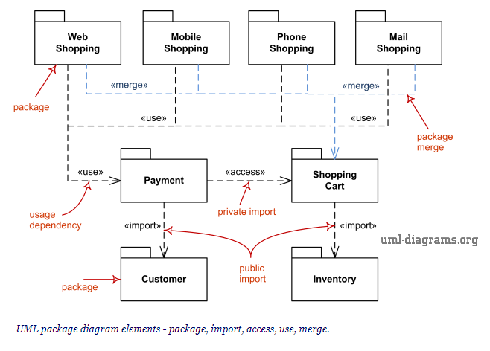

Slide 5
Sources
http://www.uml-diagrams.org/package-diagrams-overview.html

